Slide 1

STREAMERS Climate Change: An analysis of World temperature and CO2 emissions data to predict future trends. Temitope Adeniyi Feven Belay Neca Bryan
T

Slide 2

OVERVIEW
This is an analysis of the Earth’s surface temperature from 1990- 2013 and CO2 data from 1990-2018 to determine the trends and predict future temperatures in the World data.

Slide 3


CONTENTS The areas of focus for this analysis will be
Technologies – Python, Jupyter Notebook, PostgresSQL, Tableau
Database for creating tables and ascending data.
Machine Learning to predict variations from world temperature, trends of temperature, predict whether dataset above or below the world mean temperatures
Analysis of Results

Slide 4

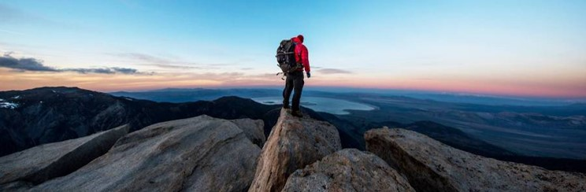
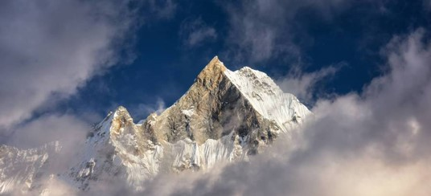
TECHNOLOGIES
The technologies utilized in this study were

Slide 5
DATABASES
The

Slide 6
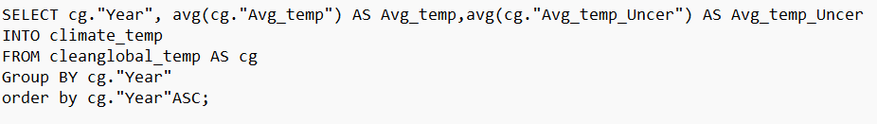
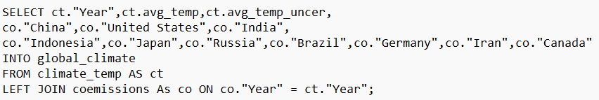
PROCESS
A SQL relational database was created labeled as"cleanglobal_temp" and "coemissions".
Other tables climate_temp" and "global_climate" were created in the PostgreSQL

Slide 7
RESULTS
https://public.tableau.com/views/NetflixBestMovies/ClimateChangestory?:language=en-US&:display_count=n&:origin=viz_share_link

Slide 8
Machine Learning Random Forest Model A mix of classification and and regression techniques to address imbalance data.

Slide 9
BENEFITS
Robust against overfitting
Rank importance of input variables
Robust to outliers & non –linear data
Efficient for large datasets

Slide 10
PROCESS
extract more current years using (.loc ) function for the years after 1900 ??
Cleaned, renamed & formatted data
Used (describe and transpose functions to access the data values (mean, std, etc.)
Transformed columns to numerical values (specific to ML use model only used numeric)
Split the data into training & testing, Ran Random Forest Model & Fit the model

Slide 11
RESULTS
Accuracy Score – 71%.
Recall – identify positive samples (sensitivity)
F1 Score – weighted avg of true positive rate
Ratio of accuracy of the model. Based on the results the predictions are 71% correct.
Classification Report
Confusion Matrix
Predicted 0 Predicted 1 Actual 0 25373 10778 Actual 1 13043 33002
Precision Recall F1 Score 0 0.66 0.70 0.68 1 0.75 0.72 0.73
Precision – reliability of the model when positive classifications are made
Confusion Matrix -

Slide 12
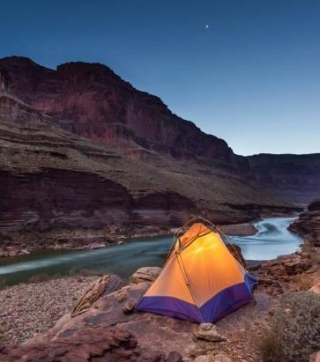



Summary
With PowerPoint, you can create presentations and share your work with others, wherever they are. Type the text you want here to get started. You can also add images, art, and videos on this template. Save to OneDrive and access your presentations from your computer, tablet, or phone.

Slide 14
RESOURCES
Berkeley Earth, affiliated Lawrence Berkeley National Laboratory
Climate Watch Data
Data

